Slide 1
SE Preparation
Prerequisites for session attendees
Browser
Public internet connection
SSH client
Optional DevCenter install
Set up the shared cluster before the session
https://github.com/Marcinthecloud/AzureTechDaySetup
Deliver content starting with this deck
Every subtitle slide in this deck corresponds to a section in the following git repo with 1 exception.
The exception is that you are free to do your own architecture or always on
demo/pitch:
https://github.com/Marcinthecloud/DataStaxDay

Slide 2
Content and Session Time
This content is designed for a 4 hour tech day
The scope used for a 2 hour session might exclude
Primary Key Exercise and/or Consistency Hands On
Cassandra Architecture Demo (Always On Demo)
Ops
Reference Architecture

Slide 3
Hands On DataStax Enterprise
Vincent Poncet – DataStax Solution Engineer
Negib Marhoul – DataStax Solution Engineer
Simon Ambridge – DataStax Solution Engineer
Tim Vincent – DataStax Solution Engineer Manager
Notes:
Challenger Commercial Teaching Steps are embedded in the talk track on this PPT deck. This content will always be bold italics and is not something you read/communicate when you deliver this deck. Instead, this is for your information only and is intended to make you provide awareness and context.
1. The Warmer = Establish relevance – ‘I understand what you’re going through’
2. The Reframe = Suggest a new point of view – ‘The problem behind your problem’
3. Rational Drowning = Support your point of view with data – ‘Not just shocking, also true’
4. Emotional Impact = Reveal the implications – ‘Bring the problem to life’
5. The New Way = Pitch a solution – ‘this is how you solve your problem’
6. Your Solution = DataStax – ‘We have the tools you need to solve your problem’

Slide 4
Today’s Agenda
10:00am - 10:30am Welcome and Introduction
10:30am - 11:00am Customer Presentation
11:00am – 11:30pm What is DataStax Enterprise? Why & when?
11:30pm - 1:00pm Hands On DSE Cassandra, Data Modeling, Ref. Architecture
12:00pm - 12:30pm Lunch
01:00pm – 02:00pm Hands On DSE Search, Reference Architecture
02:00pm - 03:00pm Hands On DSE Analytics, Spark, Streaming, Ref. Architecture
03:00pm – 03:45pm Operations and Getting Started
03:45pm - 04:00pm Wrap up and Next Steps
Notes:
That’s the kind of power you can bring into your organization.
And what that power looks like is a transactional backbone that gives you a truly distributed database. It creates industry leading performance with really predictable scalability, so that when your business needs a change, you are not stuck wondering what this is going to feel like, and you are not hammering your operations teams when you do it.
This ultimately gives you, the business, flexibility that you will need to compete in the new world.

Slide 5
Hands On Setup

Slide 6
Hands On Setup
Full hands-on steps and materials are here:
https://github.com/VincentPoncet/DataStaxDay
Follow the steps in the Logistics section to get set up
This slide deck will be sent out after the session

Slide 7
DataStax Enterprise

Slide 8
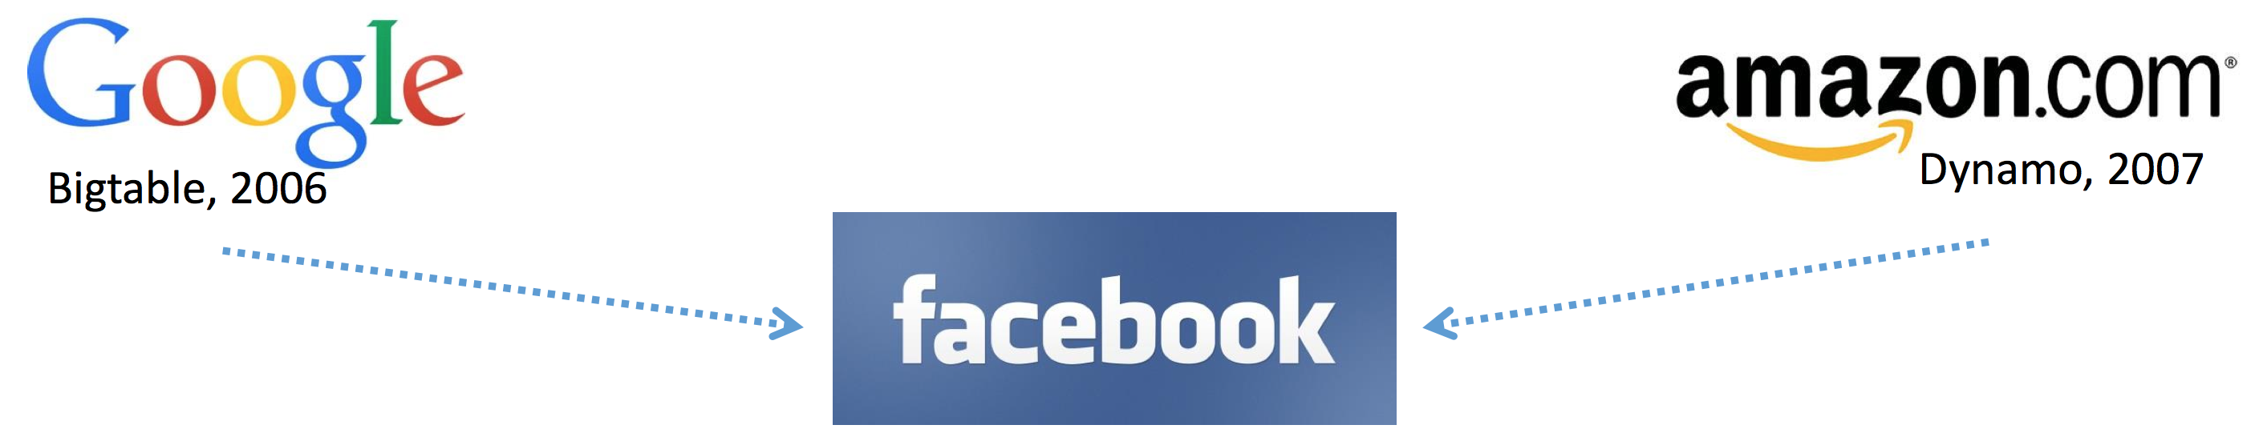

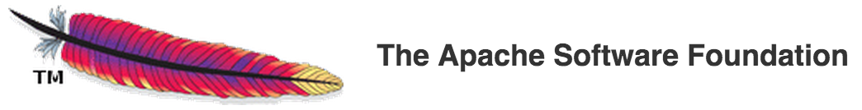
How do we handle massive transactional data and never go down?
Schema
Memtables
Compaction
SStables
Commit Log
Cluster Architecture
Partitioning
Replication
Gossip
Anti-Entropy
Hints

Slide 9
DataStax Enterprise Cassandra
read or write data
Nodes in a peer-to-peer cluster
Replicated distributed data
Tables, Rows, Columns
CQL query language
✔

Slide 10
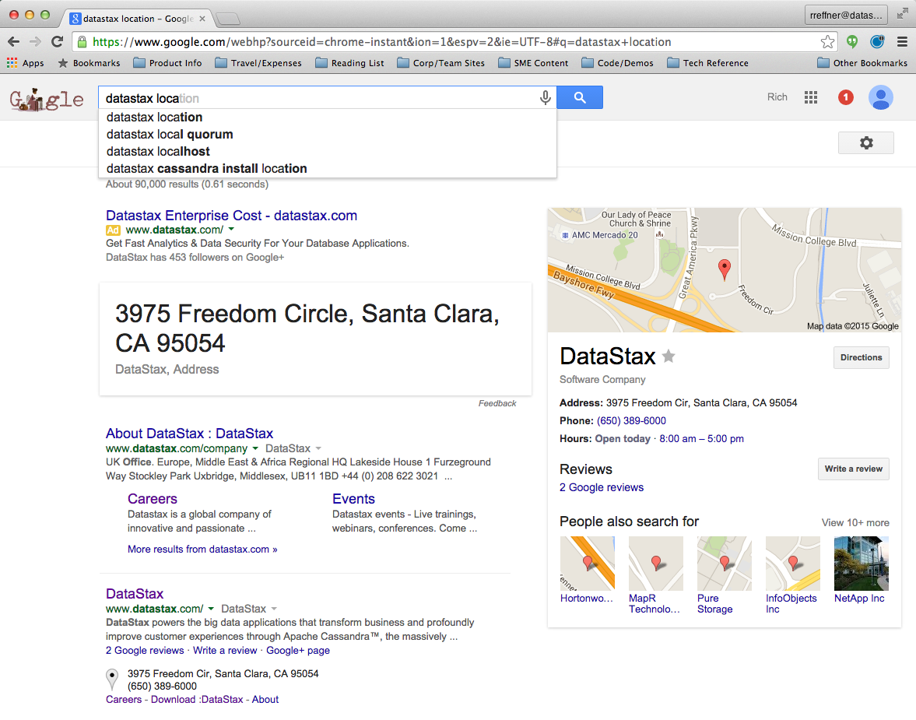
DataStax Enterprise Search
As data is inserted or updated
in Cassandra…
it is automatically indexed and
made available for search
in real time.
⬅ Get this search query functionality by simply inserting data into DSE

Slide 11



DataStax Enterprise Analytics
Data in Cassandra used by Spark
√ SQL queries, joins
√ Aggregations, functions
Streaming data processed in Spark the saved to
Cassandra
√ Real time analytics apps
√ Pre-aggregation
√ Real time parsing and ETL

Slide 12


Integrated Multi-Model Platform
Graph
Batch
Analytics
Indexing
& Search
Streaming
Analytics
12
Notes:
Cassandra's great, but it's just a database.
In order to do something useful you need to layer on other functionality. You need to do something with the data.
We've integrated an indexing engine with full text search support, both streaming and batch analytics using Spark. Coming soon is Graph with our acquisition of the team behind Titian DB.
All of this is tightly integrated within the same node. You persist the data, and we automatically maintain the indexes and materialized views in order to support these different query paths. This is what it means to be a multi-model database.

Slide 13
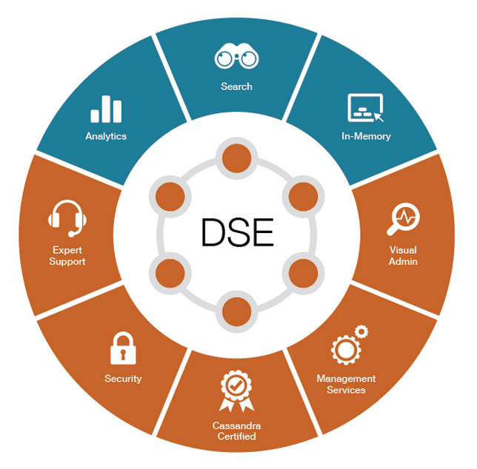
Tooling and Services

Slide 14

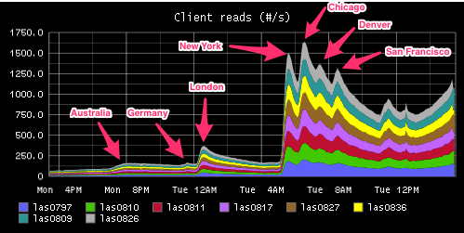
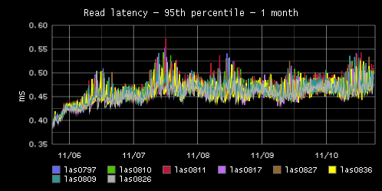
Why do our customers choose DSE?
Always On
Active/Active Distributed

Slide 15
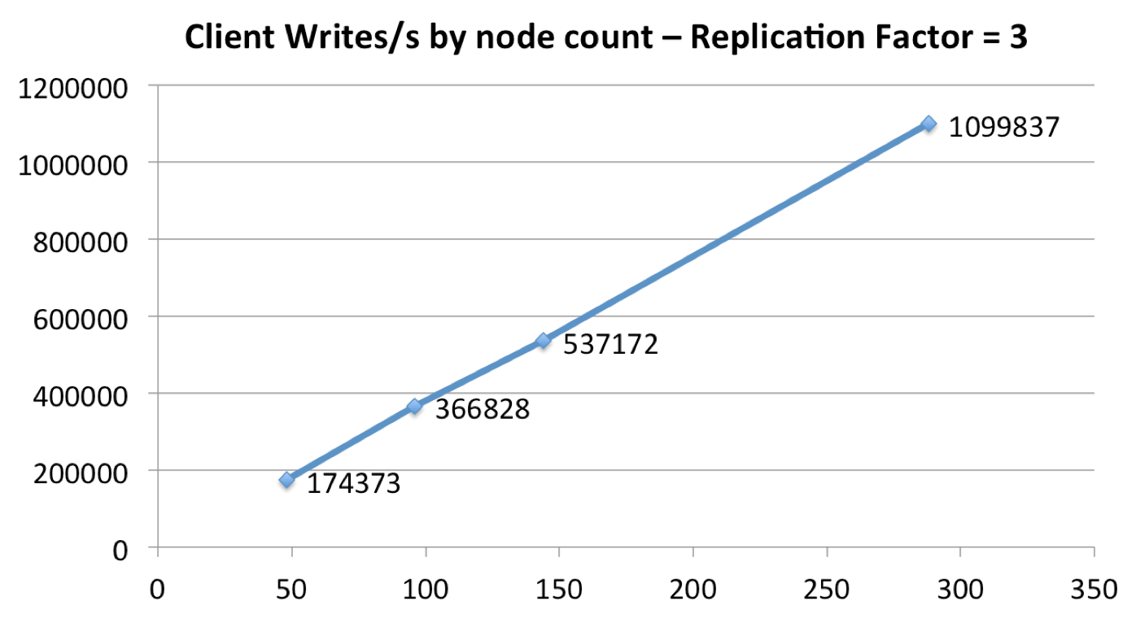
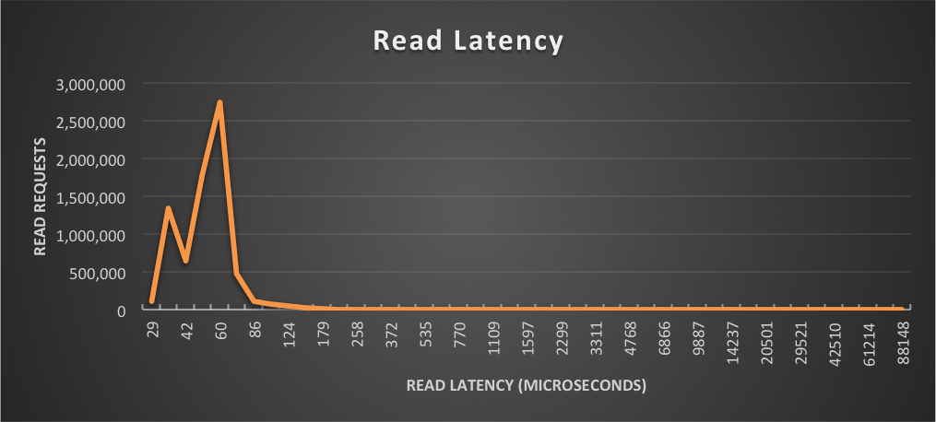
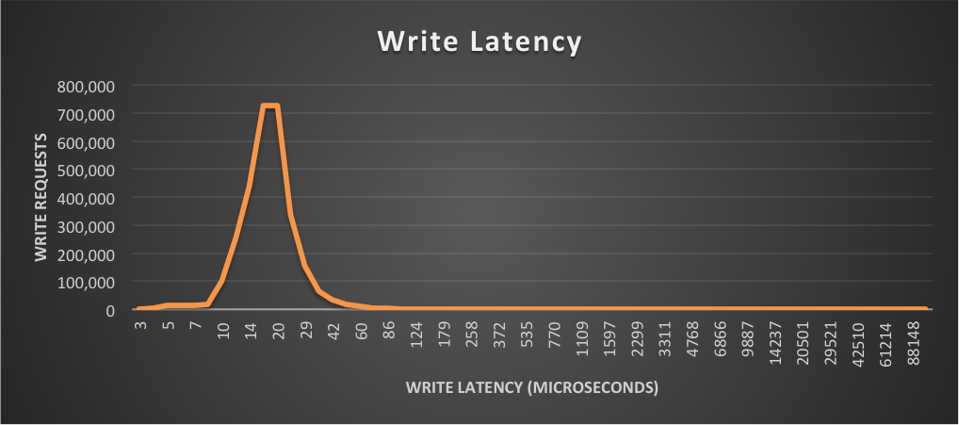
Why do our customers choose DSE?
Fast (Low Latency)
Huge linear scale

Slide 16

DSE is Unique
Integrated Functionality
Linear Scale
Low Latency
Availability
Notes:
It's the coming together of these different attributes that makes DSE unique. Nobody else has this combination.
Challenger Commercial Teaching Step =
#6 Your Solution – our solution is unique and better than anyone else

Slide 17














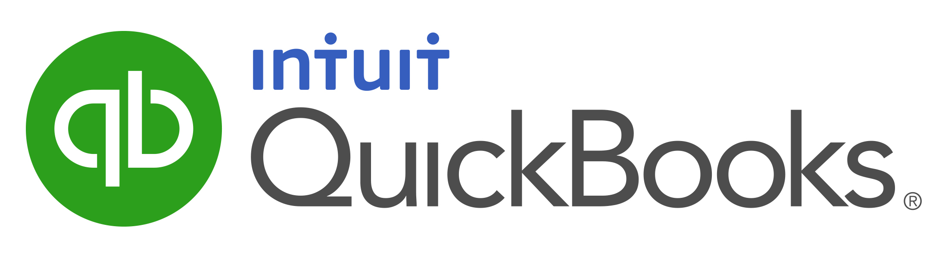
DataStax Use Cases
MDM: Customer 360, Product Catalog
Personalization and Recommendation
Internet of Things and Time Series
Fraud Detection
List Management
Messaging
Inventory Management
Authentication
Notes:
These capabilities have allowed us to penetrate deeply into financial services for mission critical applications extraordinarily quickly. I just want to give you a brief overview of some logos and use cases before we dive in.
Real Time Payments Engine: Allied Payment
Post Trade Risk Reporting/Capital Adeqquacy: Credit Suisse, UBS, BNP Paribas
Global Reference Data Replication: UBS
Market Data Capture/Replay: Blue Mountain, Sirca
Post Trade Surveillance: UBS, Credit Suisse
Real Time Fraud Analytics: Can’t share names – BofA – Fraud Analytics as part of the transactional flow. Not going to wait a minute for a period of time to determine fraud at the atm or time of a credit card transaction
Forward Curve Analytics: UBS
Challenger Commercial Teaching Step =
#4 Emotional Impact – is telling stories about other companies and/or introducing the high-level challenges we solve Multi-Channel, Fraud, etc.

Slide 18
Two Massive Trends
Intelligent
Low latency
Scalable
Available
Distributed

Slide 19
Architecture of a Cloud Application
Web App
Queue
Ingest
Operational Database
Notes:
To help place the database in context you need to know what a basic application looks like
You've got a web application that takes actions from a user, and those actions or requests go into a queue. You've then got workers that take these requests and either read or write data from the database, and optionally respond to the user.
Challenger Commercial Teaching Step =
#2 The Reframe – give perspective on challenges connecting to a bigger problem and provide explanations and implications of the insight
The architecture slides help provide context as to why a platform or holistic response is necessary to address the complexity problem

Slide 20
Architecture of a Cloud Application
Web App
Queue
Ingest
Operational Database
Search
Notes:
That works for a while, but you're going to want to add search capabilities so that you can handle complex queries and Google like full text search or recommendation that users have become accustom too.
People typically address this by adding another system like Solr or ElasticSearch and do synchronization between the main database and the search database.
Challenger Commercial Teaching Step =
#2 The Reframe – give perspective on challenges connecting to a bigger problem and provide explanations and implications of the insight
The architecture slides help provide context as to why a platform or holistic response is necessary to address the complexity problem

Slide 21
Architecture of a Cloud Application
Web App
Queue
Ingest
Operational Database
Search
Search
Batch Processing
Hive
Hadoop
Queue
Notes:
But that only gets you so far, soon you'll need to start offering true recommendations in order to drive up customer engagement, or do cross selling to increase revenue.
In order to address that need people typically add a Hadoop cluster, and that adds a whole lot more complexity and cost.
Challenger Commercial Teaching Step =
#2 The Reframe – give perspective on challenges connecting to a bigger problem and provide explanations and implications of the insight
The architecture slides help provide context as to why a platform or holistic response is necessary to address the complexity problem

Slide 22
Architecture of a Cloud Application
Spark Streaming
Web App
Queue
Ingest
Operational Database
Search
Search
Batch Processing
Hive
Hadoop
Queue
Notes:
And soon you realize that batch recommendations run every couple of days or months aren't very good because they're not contextual. They don't reflect what the user is actually doing.
To provide good personalized experience or recommendations you need to do streaming or real-time recommendations. To handle this people typically add yet another system such as Spark Streaming, or Storm.
Soon you've got at least 8 separate systems supporting one "basic" application.
Challenger Commercial Teaching Step =
#2 The Reframe – give perspective on challenges connecting to a bigger problem and provide explanations and implications of the insight
The architecture slides help provide context as to why a platform or holistic response is necessary to address the complexity problem

Slide 23
Hands on DSE Cassandra

Slide 24
Hands On Cassandra Data Model
Keyspace
Column Family /Table
Rows
Columns
Collections/UDTs

Slide 25
The Secret Sauce: PRIMARY KEY
create table sentiment(
body text, // message content
dt date, // timestamp of message
ch text, // social channel
cu int, // customer referenced
sent text, // sentiment indicator
PRIMARY KEY(???????));
PRIMARY KEY (dt)
PRIMARY KEY ((ch,dt))
PRIMARY KEY (ch,dt)
PRIMARY KEY (ch,cu,dt)
PRIMARY KEY ((ch,dt),cu)

Slide 26
No Clustering Columns
PRIMARY KEY (dt) // no duplicate primary keys
dt | cu | ch | sent | body
20160101 | 1 | facebook | positive | “That was sick!”
20160102 | 1 | twitter | negative | “I’m feeling sick!”
20160102 | 2 | facebook | negative | “I feel sick, too.”
SELECT * FROM sentiment WHERE dt = ‘1/2/2016’;

Slide 27
Compound Partition Key
PRIMARY KEY ((ch,dt)) // hash(ch,dt) ➔ token
ch | dt | cu | sent | body
facebook | 20160101 | 1 | positive | “That was sick!”
twitter | 20160102 | 1 | negative | “I’m feeling sick!”
facebook | 20160102 | 2 | negative | “I feel sick, too.”
SELECT * FROM sentiment WHERE ch = ’facebook’ AND dt = ‘1/2/2016’;

Slide 28
Clustering Columns Create Wide Rows
PRIMARY KEY (ch,dt) // default sort and range queries
ch | dt
twitter | 20160102
 | 1, negative, “I’m feeling sick!”
facebook | 20160101 | 20160102 | 20160103
 | 1, positive, “That was sick!” | 2, negative, “I feel sick, too.” | 2,positive, “dude, you’re sick”
SELECT * FROM sentiment WHERE ch = ’facebook’ and dt > ‘1/1/2016’;

Slide 29
Nested Clustering Columns
PRIMARY KEY (ch,cu,dt) // nested clustering
ch | cu,dt
twitter | 1,20160102
 | negative, “I’m feeling sick!”
facebook | 1 | 2
 | 20160101 | 20160102 | 20160103
 | positive, “That was sick!” | negative, “I feel sick, too.” | positive, “dude, you’re sick”
SELECT * FROM sentiment WHERE ch = ’facebook’ AND
cu = 2 AND dt >= 1/2/16 AND dt <= 1/3/16;

Slide 30
C* Data Modeling: Same But Different
Start with your queries
Why a query driven methodology?
No foreign keys, no joins
Denormalization is encouraged
Minimizes aggregate I/O
Think: materialized views

Slide 31
Basic Approach To C* Data Modeling
What queries are needed in your app?
What are your natural unique keys?
Is there ordering of the data needed to serve each query?
What are the groupings (1:M, M:M) in the data?
What filtering will your queries need?
Can events be stored in chronological order?
Does the data expire? Do large chunks of data expire together?

Slide 32
Hands On Cassandra Primary Keys

Slide 33
Always On
How is it possible to have no down time
and have all data available all of the time?

Slide 34
Best in Class Replication
No master-slave
Distributed self healing mesh
Peer to peer replication
No single point of failure
Writes are done to all nodes simultaneously.
Data is safe from node, rack, and datacenter failure.
Optimized for high volume, low latency operations.
Notes:
There is a reason why our database is drawn as a ring instead of the traditional one or two machines.
At the core of DataStax enterprise we use Cassandra as our database. Cassandra is different because it scales, and won't fail.
Cassandra is a master-less, self healing mesh, with no single point of failure, and true linear scalability.
Challenger Commercial Teaching Step =
#5 New Way – a point-by-point review on what they need to achieve the business case … it is about behaving differently

Slide 35
Cassandra Reference Architecture
Your Application
CQL driver
80
31
70
10
41
21
60
20
51
11
Data Center 1
Data Center 2
50
30
61
81
40
71

Slide 36
Cassandra Architecture Demo

Slide 37
C* Architecture
Application
insert key=‘x’;
driver
hash(key) => token(43)
80
31
70
10
41
21
60
20
51
11
Data Center 1
Data Center 2
50
RF = 3
30
61
RF = 3
81
40
71

Slide 38
C* Process in JVM
Snitch
Gossip
Driver
Load balancing
Coordinator
Partition key ~ token
Token ranges
Replication factor
Consistency level
Hints
Repair
Sizing
Application
driver
80
70
10
60
20
Data Center 1
50
30
40

Slide 39
What’s Stored With Each Column?
ch | dt
twitter | 20160102
 | 1, negative, “I’m feeling sick!”
facebook | 20160101 | 20160102 | 20160103
 | 1, positive, “That was sick!” | 2, negative, “I feel sick, too.” | 2,positive, “dude, you’re sick”
column name : “body”
column value : “That was sick!”
timestamp : 1353890782373000
TTL : 3600

Slide 40
Write/Read Path
row cache
INSERT INTO email_users
(domain, user, username)
VALUES ('@datastax.com',’rreffner', ’rreffner@datastax.com');
memtable A
memtable B
bloom filter
key cache
SELECT * FROM email_users
WHERE domain= '@datastax.com’
AND user = ’rreffner@datastax.com’;
memory
OS cache
storage
commit log
sstable A L1
sstable B
sstable A L2
Compaction
sstable A L3

Slide 41
Compaction
ID | NAME | DOB
BB1 | John Waters
CB2 |  | 4/20/1964
NN3 | Jim West | 4/22/1958
Note: This is a logical representation,
not the SSTable physical file format.
ID | NAME | DOB
AB1 | John Smith | 10/11/1972
AB2 | Bob Jones
ZZ3 | Mike West | 4/22/1968
CB2 | Chris Jones
BB1 | John Waters | 11/11/1974
ID | NAME | DOB
BB1 |  | 11/11/1974
CB2 | Chris Jones | 3/16/1964
NN3 | Jim West | 4/22/1958
ID | NAME | DOB
AB1 | John Smith | 10/11/1972
AB2 | Bob Jones
ZZ3 | Mike West | 4/22/1968
SSTables are immutable

Slide 42
Consistency
Replication Factor
Consistency Level
CL(write) + CL(read) > Replication Factor

Slide 43
Hands on Cassandra Consistency

Slide 44
DSE Search

Slide 45
Open Source Search Reference Architecture
Your Application
Transactional
Workloads
DB API
Search API
Search
Workloads
Your
ETL
OLTP DB
Search Cluster

Slide 46
DSE Search Reference Architecture
Your Application
Easy CQL API
All the goodness of DataStax driver
Distributed, Replicated, Always On
Data locality and shared memory
Automatic indexing on db insert
Higher ingestion throughput
Distributed query optimization
Compared to open source search
No separate search cluster to manage
Probably less total hardware required
No “Split Brain” data inconsistencies
No ETL or synch to build and maintain
No app level data management code
CQL
80
70
10
Search
+
Cassandra
60
20
50
30
40

Slide 47
DSE Search Node
Data and Index are both local
Cassandra
Lucene
Data automatically indexed on insert
Highly tunable ingest throughput
Search schema auto-generated from table definition
No redundant data storage in the Lucene index is required
memtable A
Index
memory
storage
sstable A
Index
commit log
Notes:
SSTable = sorted strings table

Slide 48
Inserting through Cassandra CQL
Coordinator Node
Replica Node
Solr
Solr
Update Handler
Update Handler
2
4
Cassandra
SI API
Cassandra
SI API
1
3
CQL INSERT
Notes:
6/9/16
48
48

Slide 49
Querying
client
Coordinator
p6
p3
p3
p3
p3
p1
p1
Replica
p6
Replica
p3
p1
p6
Replica
Notes:
6/9/16
49
49

Slide 50
Querying through CQL
SELECT title FROM solr WHERE solr_query='title:natio*';
title
--------------------------------------------------------------------------
Bolivia national football team 2002
List of French born footballers who have played for other national teams
Lithuania national basketball team at Eurobasket 2009
Bolivia national football team 2000
Kenya national under-20 football team
Bolivia national football team 1999
Israel men's national inline hockey team
Bolivia national football team 2001
Notes:
6/9/16
50
50

Slide 51
How many nodes to contact?
We don't know the primary key
Theory: contact at least one replica for every token range
Cassandra contacts all nodes
Our custom Solr SearchComponent does intelligent shard selection
Notes:
6/9/16
51
51

Slide 52
Querying through CQL
Coordinator Node
Replica Node
Solr
Solr
2
4
contacts all nodes
CQL SELECT
Cassandra
SI API
Cassandra
SI API
1
3
6
5
Notes:
6/9/16
52
52

Slide 53
DSE Analytics

Slide 54
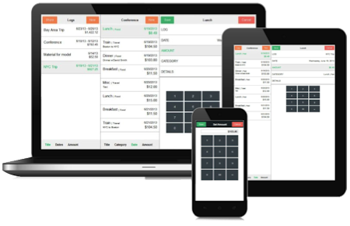
DSE Analytics Reference Architecture
Spark SQL and other goodness
Ops and Developer friendly
Streaming, Hadoop available
No ETL
Cassandra replication
saveToCassandra( )
Replicated, Distributed data
Cache datasets across jobs
Every Analytics node is a worker
True HA without Zookeeper
Master auto-election
Master auto-failover
Single DSE Custer
Your Application
Real Time Operations
Cassandra
Your Analytics
Real Time Replication
Analytics
Queries
Analytics
Notes:
Constrast that to our solution and you'll immediately see that we're simpler. We'll dig into this in detail, but I wanted to provide you with some context.
Challenger Commercial Teaching Step =
#6 Your Solution – our solution is unique and better than anyone else

Slide 55
DSE Analytics Node
Spark and Cassandra
Cassandra
Spark
Data lives in Cassandra
Spark loads data from Cassandra with predicate pushdown
Spark saves data directly to Cassandra tables
Spark Streaming available
memtable A
RDD
DataFrames
memory
storage
sstable A
commit log
Notes:
SSTable = sorted strings table

Slide 56
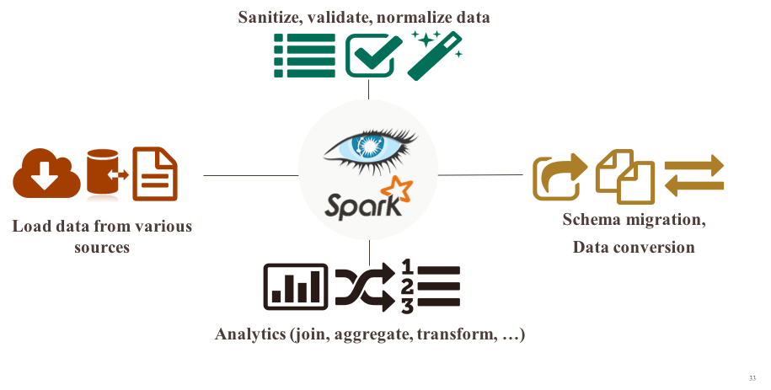
Why Spark on Cassandra?
Analytics on transactional data and operational applications
Data model independent queries
Cross-table operations (JOIN, UNION, etc.)
Complex analytics (e.g. machine learning)
Data transformation, aggregation, etc.
Stream processing

Slide 57
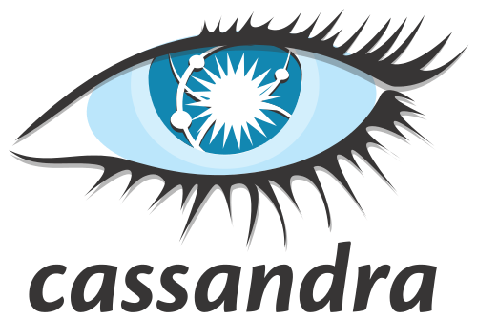


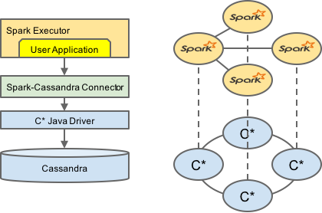
Cassandra Spark Driver
Cassandra tables exposed as
Spark RDDs
Spark DataFrames
Load data from Cassandra to Spark
Write data from Spark to Cassandra
Object mapper : Mapping of C* tables and rows to Scala/Java objects
All Cassandra types supported and converted to Scala/Java types
Server side data selection
Virtual Nodes support
Data Locality awareness
Scala, Python and Java APIs

Slide 58
Usage of Spark DataFrames
Mapping of Cassandra keyspaces and tables
Read and write on Cassandra tables
import com.datastax.spark.connector._
// Connect to the Spark cluster
val conf = new SparkConf(true)...
val sc = new SparkContext(conf)
// Create Cassandra SQL context
val sqlContext = new org.apache.spark.sql.hive.HiveContext(sc)
// Cassandra Table as a Spark DataFrame
val df = sqlContext.read.format("org.apache.spark.sql.cassandra").
options(Map("keyspace"->"music", "table" -> "tracks_by_album”)).
load()
// Some DataFrames transformations // for floor : import sqlContext.functions._
val tmp = df.groupBy((floor(df("album_year") / 10) * 10).cast("int").alias("decade")).count
val count_by_decade = tmp.select(tmp("decade"), tmp("count").alias("album_count"))count_by_decade.show
// Save the resulting DataFrame into a Cassandra Table count_by_decade.write.format("org.apache.spark.sql.cassandra").options(Map( "table" -> "albums_by_decade", "keyspace" -> "steve")).mode(SaveMode.Overwrite).save()

Slide 59
Usage of Spark SQL
Mapping of Cassandra keyspaces and tables
Read and write on Cassandra tables
import com.datastax.spark.connector._
// Connect to the Spark cluster
val conf = new SparkConf(true)...
val sc = new SparkContext(conf)
// Create Cassandra SQL context
val sqlContext = new org.apache.spark.sql.hive.HiveContext(sc)
// Create the SparkSQL alias to the Cassandra Table
sqlContext.sql(“””CREATE TEMPORARY TABLE tmp_tracks_by_album
USING org.apache.spark.sql.cassandra
OPTIONS (keyspace "music", table "tracks_by_album”)”””)
// Execute the SparkSQL query. The result of the query is a DataFrame
val track_count_by_year = sqlContext.sql("select 'dummy' as dummy, album_year as year,
count(*) as track_count
from tmp_tracks_by_album
group by album_year")
// Register the DataFrame as a SparkSQL alias
track_count_by_year.registerTempTable("tmp_track_count_by_year”)
// Save the DataFrame using SparkSQL Insert into
sqlContext.sql("insert into table music.tracks_by_year select dummy, track_count, year from tmp_track_count_by_year")

Slide 60
DataStax Enterprise Max - Spark Special Features
Easy setup and config
No need to setup a separate Spark cluster
No need to tweak classpaths or config files
High availability of Spark Master
Enterprise security
Password / Kerberos / LDAP authentication
SSL for all Spark to Cassandra connections
Included support of Apache Spark in DSE Max subscription

Slide 61
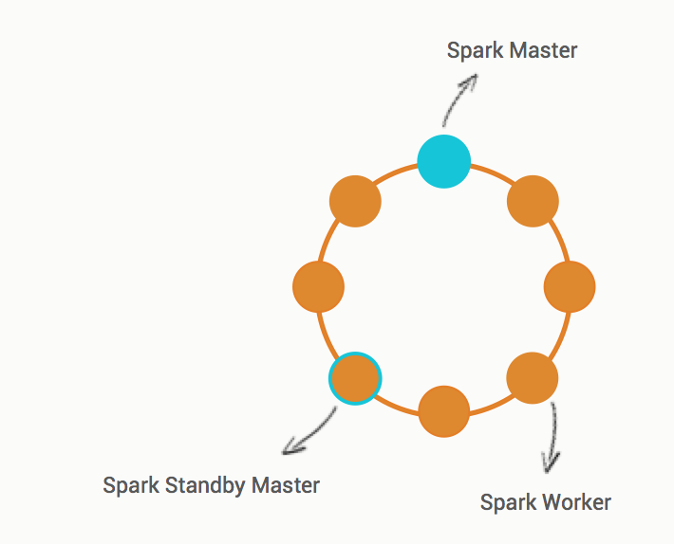
DataStax Enterprise - High Availability
All nodes are Spark Workers
By default resilient to Worker failures
First Spark node promoted as Spark Master ( state saved in Cassandra, no SPOF)
Standby Master promoted on failure (New Spark Master reconnects to Workers and the driver app and continues the job)
No need of Zookeeper, unlike
Spark Standalone
Mesos
YARN
Notes:
Master HA out of the box with DSE
A Spark Master controls the workflow, and a Spark Worker launches executors responsible for executing part of the job submitted to the Spark master.

Slide 62
DSE Streaming Reference Architecture
Single DSE Custer
Streaming
Analytics
Your Application
Message Queue
Batch
Analytics
Real-time
Notes:
Constrast that to our solution and you'll immediately see that we're simpler. We'll dig into this in detail, but I wanted to provide you with some context.
Challenger Commercial Teaching Step =
#6 Your Solution – our solution is unique and better than anyone else

Slide 63
Getting Started With DSE Ops

Slide 64
Getting Started: Pro-Tips
Use appropriate infrastructure
Get your data model right
Know the DataStax driver
Code good query patterns
Size your cluster correctly

Slide 65
Getting Started: Pro-Tips
Use appropriate infrastructure
Get your data model right
Know the DataStax driver
Code good query patterns
Size your cluster correctly
Nodes not too big
Nodes not too small
^ See docs
Avoid shared storage
Physical or virtual are OK

Slide 66
Getting Started: Pro-Tips
Use appropriate infrastructure
Get your data model right
Know the DataStax driver
Code good query patterns
Size your cluster correctly
Denormalize
No RDBMS models
No secondary indexes
Get help if you’re stuck!
Great online resources

Slide 67
Getting Started: Pro-Tips
Use appropriate infrastructure
Get your data model right
Know the DataStax driver
Code good query patterns
Size your cluster correctly
Load balancing/routing
Retry and auto-failover
Session management
Language features

Slide 68
Getting Started: Pro-Tips
Use appropriate infrastructure
Get your data model right
Know the DataStax driver
Code good query patterns
Size your cluster correctly
Asynchronous queries
Prepared statements
Use batches correctly

Slide 69
Getting Started: Pro-Tips
Use appropriate infrastructure
Get your data model right
Know the DataStax driver
Code good query patterns
Size your cluster correctly
Correct number of nodes
Use default heap settings
Always load test

Slide 70
DSE Performance Basics
Can DSE be both bigger and faster? Yes it can.
More Throughput? More Data?
Use more nodes (scale out)
Do not use too big nodes (scale up)
Know Cassandra ops best practices Use OpsCenter to monitor, alert, repair
Faster Operations? Predictable Latency?
Check your data model and queries
Use asynchronous queries
Use prepared statements
Compaction tuning or maybe strategy

Slide 71
Take DataStax Ops Training. It’s Free.
Deploy your cluster correctly
Monitor and alert the right metrics
Use repair correctly
Scale out

Slide 72
Cloud App Reference Architecture

Slide 73
Architecture of a Cloud Application
Spark Streaming
Web App
Queue
Ingest
Operational Database
Search
Search
Batch Processing
Hive
Hadoop
Queue
Notes:
And soon you realize that batch recommendations run every couple of days or months aren't very good because they're not contextual. They don't reflect what the user is actually doing.
To provide good personalized experience or recommendations you need to do streaming or real-time recommendations. To handle this people typically add yet another system such as Spark Streaming, or Storm.
Soon you've got at least 8 separate systems supporting one "basic" application.
Challenger Commercial Teaching Step =
#2 The Reframe – give perspective on challenges connecting to a bigger problem and provide explanations and implications of the insight
The architecture slides help provide context as to why a platform or holistic response is necessary to address the complexity problem

Slide 74
Why DSE Instead of Open Source?
Time to Market
We built the
integrations for you.
Lower TCO
It’s easy to operate.
Open source code
can be painful.

Slide 75
Next Steps

Slide 76
What Next?
We’ll keep this cluster up and running until Tuesday
Build use cases on it and reach out for help
mselwan@datastax.com
rreffner@datastax.com
Get smart on DSE
http://www.academy.datastax.com
http://docs.datastax.com
https://github.com/Marcinthecloud/DataStaxDay

Slide 77
Hands On DataStax Enterprise
Marc Selwan – DataStax Solution Engineer
Rich Reffner – DataStax Solution Engineering West Americas
Notes:
Challenger Commercial Teaching Steps are embedded in the talk track on this PPT deck. This content will always be bold italics and is not something you read/communicate when you deliver this deck. Instead, this is for your information only and is intended to make you provide awareness and context.
1. The Warmer = Establish relevance – ‘I understand what you’re going through’
2. The Reframe = Suggest a new point of view – ‘The problem behind your problem’
3. Rational Drowning = Support your point of view with data – ‘Not just shocking, also true’
4. Emotional Impact = Reveal the implications – ‘Bring the problem to life’
5. The New Way = Pitch a solution – ‘this is how you solve your problem’
6. Your Solution = DataStax – ‘We have the tools you need to solve your problem’

Slide 78
Fillers if extra time
Data model use cases
OpsCenter operations
Code samples of asynch prepared queries
Sizing basics

